Slide 1
What to expect When you have a 6th Grader
First Colony Middle School

Slide 2
Elementary Vs Middle School
Parent Newsletter - No Tuesday folders
4:10 PM Dismissal is the bell – not walked out
Classes 50 minutes with a 5 min pass period
No car rider tags
Outclass” is a Fine Art, Elective and PE class
Tardies are counted after first few weeks
Hall and PE lockers (combo lock needed for PE)
Homework is not optional
Late work policy – 10 points per day

Slide 3
6th Grade Courses:
English Language Arts (ELA)
Math
Science
Social Studies
Physical Education, Pre-athletics OR Kickstart
Fine Art – Band, Mariachi, Choir, Art, Orchestra, Theatre OR Robotics
AVID 6 (study skills, organization, time management)
Advisory = Tuesdays and Wednesdays

Slide 4
6TH GRADE PRE-ATHLETICS
The course would be designed to prepare students and parents for successful participation in the middle school athletic program. The focus of the program would be to provide students with a preview of upcoming UIL sports in which they will be eligible to participate as 7th graders and to prepare them for the behavioral and academic expectations associated with being a participating member of the FBISD athletic program. Students will be introduced to the concepts of UIL and FBISD academic requirements and how they impact and affect extracurricular participation.

Slide 5
01.
A desire to participate in FBISD athletics as a 7th grader.
REQUIREMENTS FOR PARTICIPATION:
02.
Dress out and participate daily.Must have athletic shoes and cleats (for football and soccer).
03.
Written permission/parental consent for participation required.

Slide 6
Sport specific skills will be taught in a rotational format. Football, Volleyball, Basketball, Track & Field, Soccer, Tennis, and Cross Country will have milti-week rotations that will occur throughout the year.
FBISD Pre-Athletics curriculum, will also include a character education program. Each week students will have an opportunity to work through and improve themselves through interaction with the character education curriculum.
COMPONENTS OF THE PRE-ATHLETIC PROGRAM
All students will have their grades and academic progress monitored consistent with current athletic department procedures and expectations. Students will understand how their academic progress impacts their eligibility and ability to participate in UIL activities.
Students will complete a daily dynamic warmup that will focus on proper running form, body control, agility, explosive movements, and physical strenth.
Weightlifting will be introduced to students and will be age appropriate. The development of appropriate and proper technique will be reinforced. Utilizing body weight, students will learn proper technique and fundamentals of weightlifting safely. When proficiency is established, weight will be added in incremental fashion.
Students will be allowed to play games, competitive activities, and mini tournaments in the class period to build interest and enthusiasm for participation in the athletic program.

Slide 7
Level Options:
On-Level or AAC
English • Math • Science• Social Studies

Slide 8
AAC = Advance Academic Course
Higher level of rigor
Fast –paced
Additional daily study time is needed
Special assignments: Science Fair, History Project, etc.
GT students are required to enrolled in identified area (Math/Science, ELA/SS)

Slide 9
AAC MatH 6
Accelerated Curriculum
100% of 6th Grade TEKS
51% of 7th Grade TEKS
Covers 150% of the middle school TEKS. Students spend less time in a math classroom than they do in Elementary School.

Slide 10
Senate Bill 2124
Please note, in compliance with Senate Bill 2124, students who score in the top 40% on 5th grade STAAR are automatically enrolled in Grade 6 Math AAC.
The standards covered in each middle school math course are listed below. Due to the acceleration, multiple grade level TEKS are covered in grades 6 and 7, to prepare students for Algebra in Grade 8.
Grade 6 Math AAC covers: 6th grade TEKS and some 7th Grade TEKS (students will take 6th grade STAAR)
Grade 7 Math AAC covers: 7th grade TEKS and all 8th Grade TEKS (students will take7th grade STAAR)
Algebra I AAC, and cover Algebra I TEKS (students will take Algebra I EOC STAAR)
If your student chooses not to be automatically enrolled in Grade 6 Math AAC, they should enroll in Grade 6 On-Level Math and inform the middle school counselor.

Slide 11
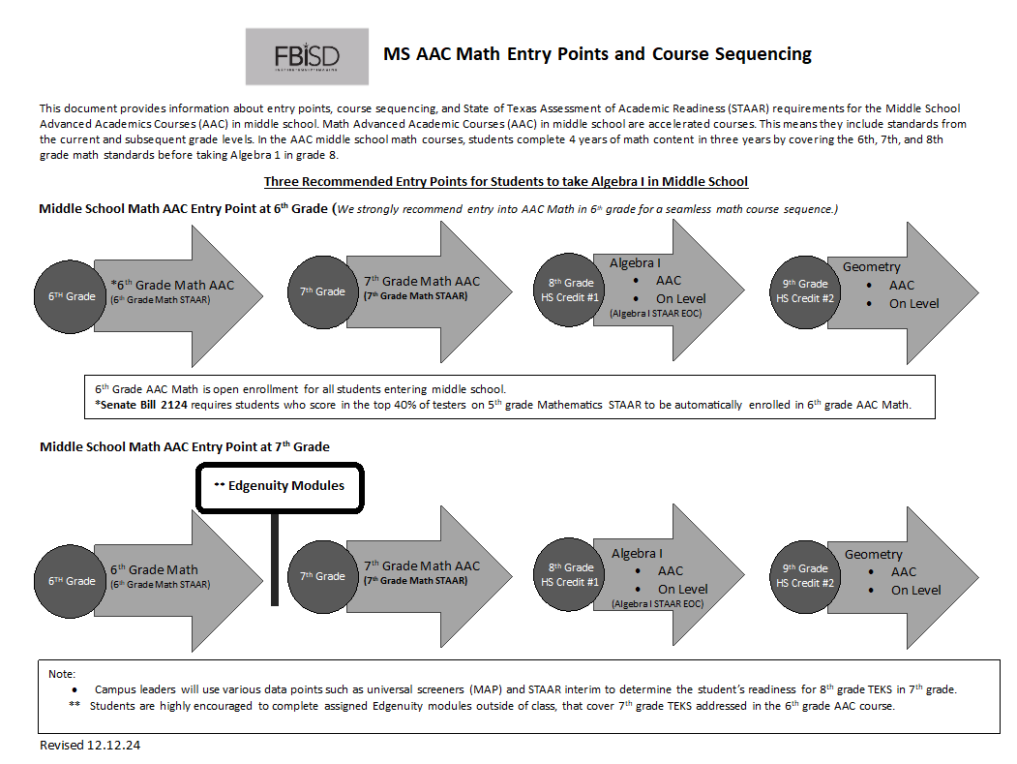

Slide 12
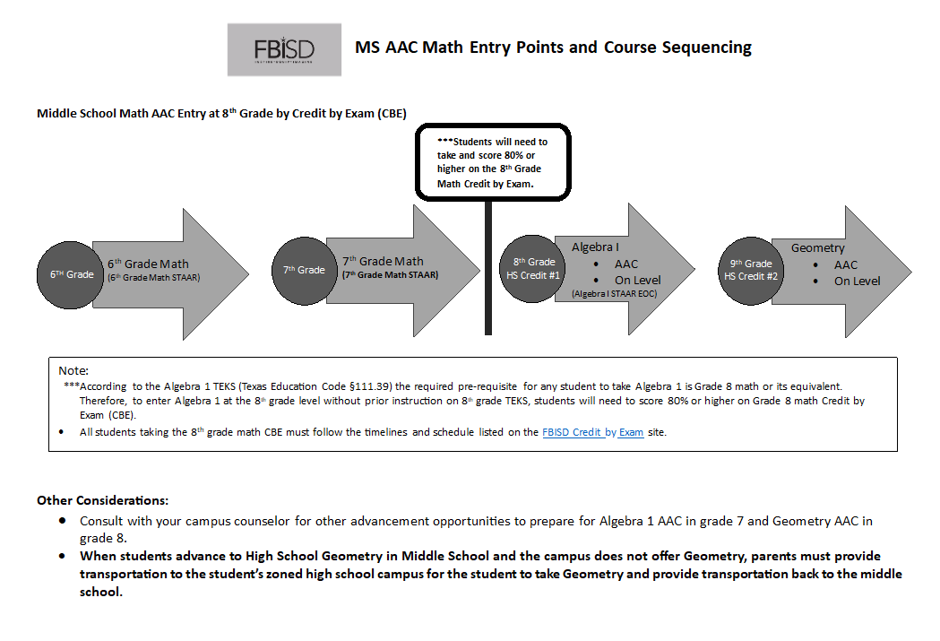

Slide 13
Success in AAC
Consistent, strong performance in subject area (Grades, REN360, Tests, Quizzes, STAAR scores)
Organized
Self-disciplined
Highly motivated

Slide 14
On-Level
On-level classes – High standards, strong academic focus
Both levels prepare students for high school
Not “All or Nothing” – Student does not have to take all On-level or all AAC, student can select levels based on interests and strengths

Slide 15
Time Management
Daily Homework
Projects
Sports/Clubs
Household Chores
Family Time
Volunteer Work

Slide 16
Proven Strategies for School Success:
Check grades together on Skyward Family Access (parent and student)
Organization – Breaking down assignments (do not do everything the day before)
Planner – Use daily for organization (paper or app)
Check Schoology (parent and student)
Limit technology during school week
Family Calendars
Pack homework the night before (binder or folder)

Slide 17
Course Verification Window
Verification Window in Skyward March 3 – 7
Review Course Requests in Skyward.
If you would like to make changes, print out and update your requests.
This will be the last opportunity to request changes.

Slide 18
Elective classes
In order to maintain balance of classroom numbers and to minimize disruptions to the academic process, schedule changes will only be made to correct on error:
A student has already taken a class in which they are currently scheduled.
A male has been scheduled into a female PE/Athletics, or vice versa
A student is in a class for which they do not have the appropriate prerequisite (i.e., enrolled in Art I and has not taken Art II).

Slide 19
Guidelines for Exiting aAC Course
Fort Bend ISD 079907
EED-R
Requests to level down will be considered after the first three (3) weeks of school and only if space is available in the new class. Prior to requesting a change in level, the student and parent must have met with the teacher and put in place a plan for success. If the teacher and student feel the plan has been followed, and the student has completed all assignments, a request for a conference to discuss removal may be made. Success in an AP or AAC course is defined as having a grade of 75 or above. Students may not request a level change with the intent to improve their GPA.

Slide 20
Follow-up questions
For individualized questions/advice on your child’s course selection, please contact your child’s elementary school counselor.
The elementary school counselors and fifth grade teachers have experience and helpful information available for parents and students regarding the transition to middle school.

